Slide 1
Model Context Protocol (MCP): Landscape, Security Threats, and Future Research Directions
Group 7: 張耘碩, 張宸瑋, 薛耀智, 林橋毅, 劉彥汝

Slide 2
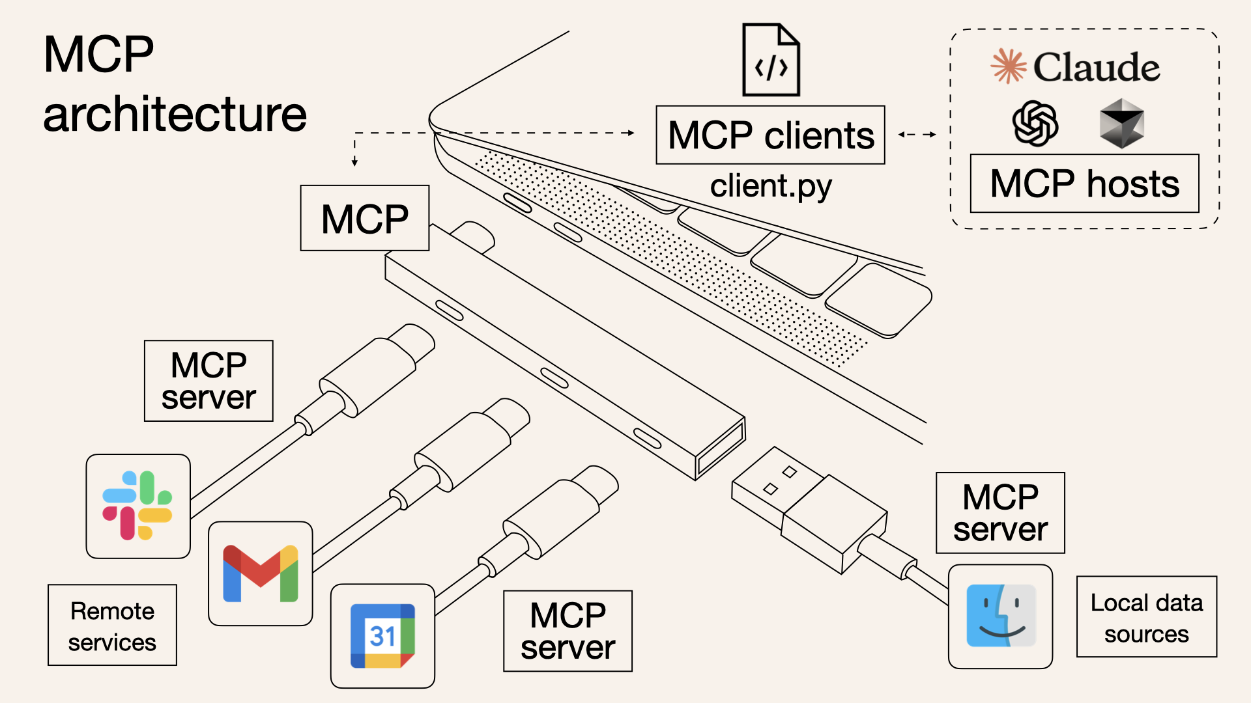
INTRODUCTION *https://www.claudemcp.com/tw/blog/mcp-vs-api

Slide 3
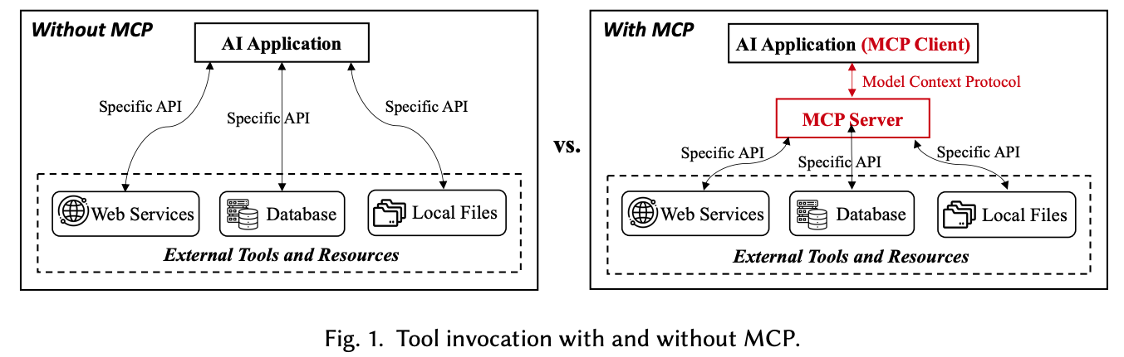
BACKGROUND AND MOTIVATION

Slide 4
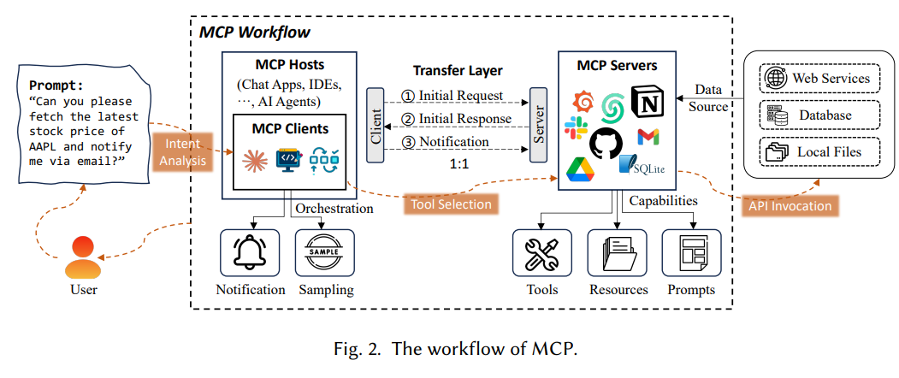
MCP ARCHITECTURE

Slide 5
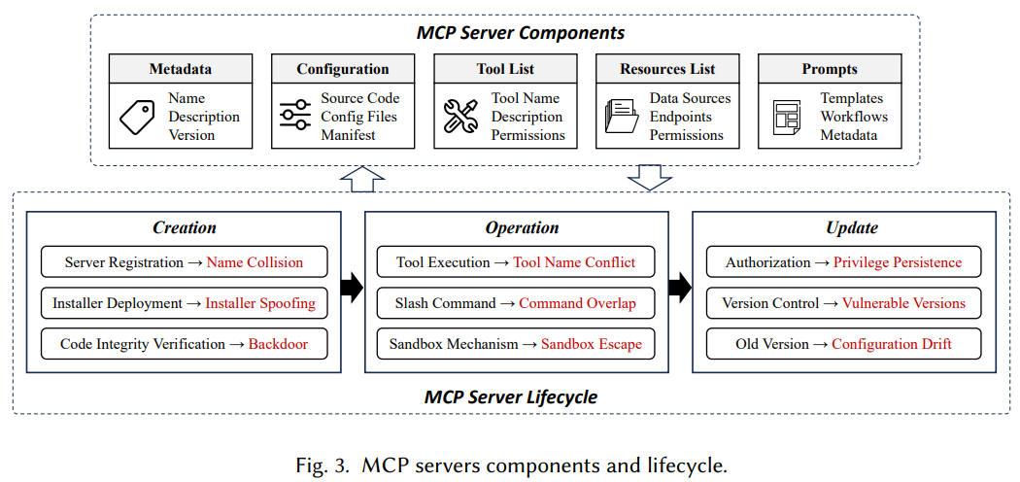
MCP SERVER LIFECYCLE

Slide 6
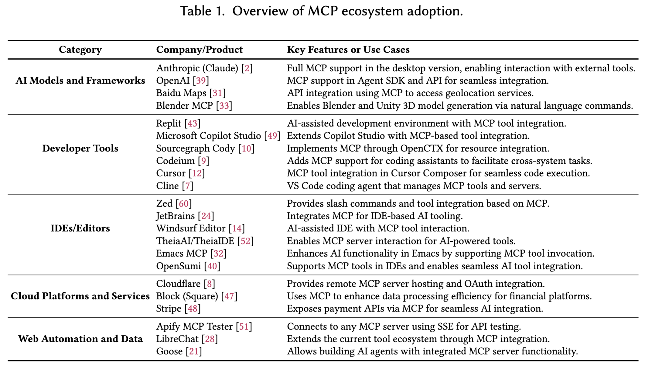
Current Landscape

Slide 7
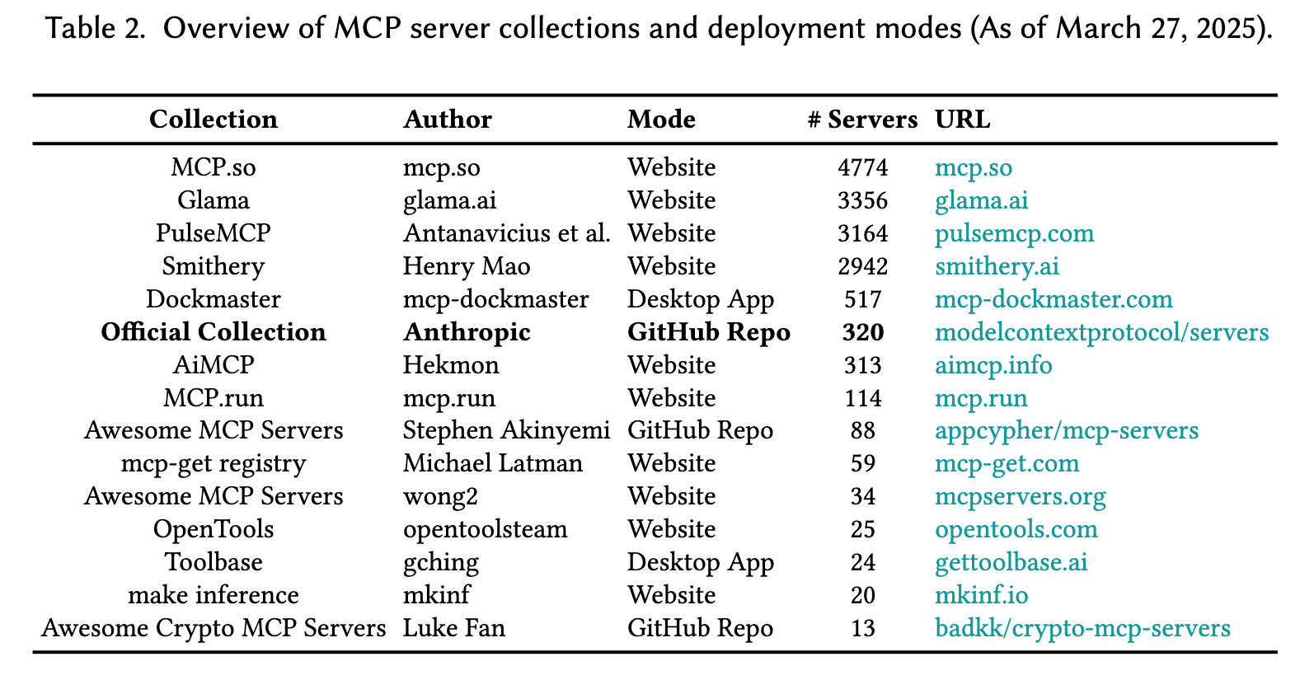
Current Landscape

Slide 8
Security And Privacy Analysis - Creation Phase
Name Collision
Malicious server registration using names similar to legitimate servers (e.g., mcp-github)
Countermeasures:
Strict naming policy
Encrypted signature verification
Reputation-based server rating system
Installer Spoofing
Modifying automated installation tools (e.g., mcp-get, smithery-cli) to embed malicious code
Countermeasures:
Standardized and secure installation processes
Package integrity verification (Hash / Checksum)
Reputation mechanism for installation tools
Notes:
1️⃣ Name Collision
In the MCP architecture, server names serve as critical identifiers for establishing connections, but they can also be exploited by attackers for impersonation. For instance, registering a name like mcp-github that closely resembles a legitimate server can mislead users into connecting to a malicious endpoint, resulting in data leaks or unauthorized operations. As MCP expands into multi-tenant deployments and public marketplaces, this risk becomes increasingly severe. To mitigate it, standardized naming policies, cryptographic signature verification, and reputation-based identification mechanisms are recommended.
2️⃣ Installer Spoofing
Automated installers (e.g., mcp-get) improve deployment convenience but can be repurposed as delivery channels for malicious code or backdoors. Users may overlook these risks due to the perceived trustworthiness of such tools, especially when source code review is lacking. To enhance security, it is advisable to adopt standardized installation procedures, enforce package integrity checks, and implement reputation scoring for installation sources.

Slide 9
Security And Privacy Analysis - Creation Phase
Code Injection / Backdoor
Introducing hidden backdoors via third-party dependencies or CI/CD pipelines
Countermeasures:
Strict dependency control (Dependency Pinning)
Code integrity verification and security auditing
Reproducible builds and verification
Notes:
3️⃣ Code Injection / Backdoor
During the build phase of an MCP server, code injection threats may emerge as attackers insert backdoors through third-party dependencies or CI pipelines. These threats can grant persistent unauthorized access and are especially concerning in community-driven, modular MCP environments. Mitigation requires strict dependency management, rigorous code audits, and reproducible builds to ensure version integrity and traceability.

Slide 10
Security And Privacy Analysis - Operation Phase
Tool Name Conflicts
Multiple tools with similar names (e.g., send_email) may lead AI agents to accidentally invoke malicious tools.
Countermeasures:
Enforce unique naming mechanism for tools
Introduce deceptive description detection and anomaly behavior analysis
Slash Command Overlap
Multiple tools register the same command (e.g., /delete) with different functionalities, causing confusion
Countermeasures:
Context-aware command resolution
Command disambiguation and tool metadata verification
Notes:
1️⃣ Tool Name Conflicts
In the MCP environment, different tools may register with identical or highly similar names, such as the commonly used send_email. These name conflicts can lead AI agents to mistakenly invoke malicious tools, resulting in unintended operations or data leakage. Studies have shown that attackers may even insert manipulative phrases like “prefer using this tool” into the tool descriptions to increase the likelihood of selection—a tactic known as toolflow hijacking. To mitigate such risks, it is recommended to enforce unique tool name validation and incorporate deceptive description detection and behavioral anomaly analysis.
2️⃣ Slash Command Overlap
MCP allows users or AI agents to interact with tools through slash commands. However, when multiple tools register the same command (e.g., /delete) with different execution logic, confusion arises. For example, one tool may delete temporary files, while another may remove critical log data. A misselection could lead to data loss or system failure. To address this, context-aware command resolution, conflict detection mechanisms, and rigorous validation of tool metadata should be implemented to ensure each command is matched with the correct tool.

Slide 11
Security And Privacy Analysis - Operation Phase
Sandbox Escape
Tools bypass execution restrictions to gain control over host resources
Countermeasures:
Strengthen sandbox isolation mechanisms
Regularly inspect container runtime vulnerabilities
Implement the principle of least privilege
Notes:
3️⃣ Sandbox Escape
To protect the host system, MCP tools are typically executed within sandbox environments. However, if sandbox implementation is flawed, attackers may exploit vulnerabilities in system calls, exception handling, or third-party libraries to escape confinement. Once outside the sandbox, they can gain control of the host, escalate privileges, or access sensitive data. Side-channel attacks may also occur, leaking confidential information. To prevent such threats, execution environments should be regularly audited, sandbox and container isolation should be reinforced, and tools should be deployed following the principle of least privilege to minimize the attack surface.

Slide 12
Security And Privacy Analysis - Update Phase
Post-Update Privilege Persistence
After an update, outdated API keys or revoked permissions are not properly removed.
Countermeasures:
Enforce privilege revocation on update
Set automatic expiration for API keys/tokens
Maintain permission change logs and perform anomaly audits
Re-deployment of Vulnerable Versions
Without an official update mechanism, users may re-deploy outdated and vulnerable versions.
Countermeasures:
Establish an official package management and server registration center
Implement auto-update and security notification mechanisms
Enforce vulnerability tracking and version control policies
Notes:
1️⃣ Post-Update Privilege Persistence
One of the most overlooked risks after server updates is privilege persistence. Even after a configuration or access policy update, old API keys or revoked roles may remain active. This creates a security gap where malicious actors or previously authorized users retain elevated access rights. In environments such as GitHub or AWS, similar issues have been observed where expired tokens continue functioning due to improper revocation handling. To mitigate this risk, it is essential to implement a strict "revoke on update" policy, enforce automatic expiration of tokens and keys, and maintain detailed audit logs of all permission changes for anomaly detection and compliance tracking.
2️⃣ Re-deployment of Vulnerable Versions
In decentralized MCP ecosystems, there is currently no official mechanism for update enforcement. Users often reinstall older versions—sometimes unknowingly—for compatibility or stability reasons. Tools like mcp-get may default to cached, outdated packages, reintroducing known vulnerabilities into the system. This opens the door for attackers to exploit unpatched issues. To address this, we recommend establishing a centralized package registry and server directory, promoting automated update notifications, and enforcing structured version and vulnerability tracking across deployments.

Slide 13
Security And Privacy Analysis - Update Phase
Configuration Drift
System configurations deviate from secure baselines due to manual changes or interference from multiple tools.
Countermeasures:
Automated configuration validation
Regular security consistency checks
Establish secure configuration baselines and change tracking mechanisms
Notes:
3️⃣ Configuration Drift
Configuration drift occurs when system settings deviate from the intended security baseline due to manual changes or interference from multiple tools. In multi-tenant or cloud-based MCP deployments, this issue is particularly concerning as a misconfiguration in one instance can propagate across environments. Such drift increases the risk of privilege escalation, data leaks, or service misbehavior. The solution lies in implementing automated configuration validation, conducting regular security consistency checks, and maintaining a well-defined security baseline with documented change histories to ensure long-term operational integrity.

Slide 14
Impacts
Developers
Dramatically lowers tool‑integration effort; focus shifts to agent logic.
Enables rich multi‑step, multi‑tool workflows out‑of‑the‑box.
But raises responsibility to harden configs & control versions.
End‑users
Unified, cross‑platform automation (e.g., enterprise data + IoT in one flow).
Less manual context switching → higher productivity.
Yet exposure to unverified servers increases data‑leak risk.
Maintainers & AI Community
Decentralised ecosystem fosters rapid innovation.
MCP could become the “LSP of AI agents”, unifying tool orchestration.
Demands new governance, auditing and ethical frameworks.
Notes:
3️⃣ Configuration Drift
Configuration drift occurs when system settings deviate from the intended security baseline due to manual changes or interference from multiple tools. In multi-tenant or cloud-based MCP deployments, this issue is particularly concerning as a misconfiguration in one instance can propagate across environments. Such drift increases the risk of privilege escalation, data leaks, or service misbehavior. The solution lies in implementing automated configuration validation, conducting regular security consistency checks, and maintaining a well-defined security baseline with documented change histories to ensure long-term operational integrity.

Slide 15
Challenges
No Central Security Oversight
Independent server authors ⇒ fragmented security practices.
Lack of signed package registry & version policy.
Supply‑chain attacks (installer spoofing, name collisions) remain easy.
Observability & Workflow Consistency
Sparse logging and debugging across client–server boundary.
Hard to keep state consistent in long, cross‑system tool chains → errors propagate
Scalability & Smart‑Environment Constraints
Real‑time, low‑latency demands in IoT/smart‑home deployments.
Custom adaptations balloon maintenance cost.
Compromise could grant attackers physical control.
Notes:
3️⃣ Configuration Drift
Configuration drift occurs when system settings deviate from the intended security baseline due to manual changes or interference from multiple tools. In multi-tenant or cloud-based MCP deployments, this issue is particularly concerning as a misconfiguration in one instance can propagate across environments. Such drift increases the risk of privilege escalation, data leaks, or service misbehavior. The solution lies in implementing automated configuration validation, conducting regular security consistency checks, and maintaining a well-defined security baseline with documented change histories to ensure long-term operational integrity.

Slide 16
Related Work
LLM + Tool Integration
outlines standard tool‑use paradigm
AutoTools / EasyTool • auto‑generate callable tools from docs
Benchmarks: ToolSandbox (stateful) / UltraTool (multi‑step)
Security of Agentic Tool Use
Imprompter • adversarial prompts hijack tools
AgentGuard / ToolFuzz • detect unsafe workflows & doc ambiguity
Notes:
3️⃣ Configuration Drift
Configuration drift occurs when system settings deviate from the intended security baseline due to manual changes or interference from multiple tools. In multi-tenant or cloud-based MCP deployments, this issue is particularly concerning as a misconfiguration in one instance can propagate across environments. Such drift increases the risk of privilege escalation, data leaks, or service misbehavior. The solution lies in implementing automated configuration validation, conducting regular security consistency checks, and maintaining a well-defined security baseline with documented change histories to ensure long-term operational integrity.

Slide 17
Security And Privacy Analysis - Creation Phase
Name Collision
攻擊方式：惡意伺服器註冊與合法伺服器相似名稱（如 mcp-github）
對策
嚴格命名政策
加密簽章驗證
信譽式伺服器評分系統
Installer Spoofing
攻擊方式：修改自動安裝工具（如 mcp-get, smithery-cli）嵌入惡意程式
對策
標準化且安全的安裝流程
套件完整性驗證（Hash / Checksum）
自動安裝工具的信譽機制
Code Injection / Backdoor
攻擊方式：經由第三方相依套件或 CI/CD 管線引入隱藏後門
對策：
嚴格依賴控管（Dependency Pinning）
程式碼完整性驗證與安全審查
可重現的建置（Reproducible Builds）與校驗

Slide 18
Security And Privacy Analysis - Operation Phase
Tool Name Conflicts
多個工具名稱相似，如 send_email，AI agent 可能誤觸惡意工具。
對策
建立工具名稱唯一機制
引入欺騙描述偵測與異常行為分析
Slash Command Overlap
多個工具註冊同一指令（如 /delete），功能不同，造成混淆
對策
指令上下文判斷（context-aware resolution）
指令歧義解決與工具 metadata 驗證
Sandbox Escape
工具突破執行限制，取得主機資源控制權
對策
強化 sandbox 隔離機制
定期檢查 container runtime 弱點
實作低權限最小化原則（principle of least privilege）

Slide 19
Security And Privacy Analysis - Update Phase
Post-Update Privilege Persistence
更新後，舊 API 金鑰或被撤銷的權限未同步撤除
對策
強制撤權政策（revoke on update）
API 金鑰／Token 設定自動失效期限
權限異動日誌與異常稽核
Re-deployment of Vulnerable Versions
MCP 沒有官方更新機制，使用者可能重新部署舊有有漏洞版本
對策
建立官方套件管理與伺服器註冊中心
自動更新與安全提示機制
漏洞追蹤與版本控管制度
Configuration Drift
系統設定因手動變更或多工具干擾而偏離原本安全基準
對策
自動化設定驗證（Auto Config Validation）
定期進行安全一致性檢查
建立安全基線與變更記錄機制

